Slide 1
Resume extraction
Team NLP
Sukriti Macker, Nishchay Vaid, Anish Mitra and Zeynep Nilsu Bozan

Slide 2
Problem description
Parsing resumes with very different formats and inputting the important information into the company database is something that sites with widespread usage such as workday do not do accurately.
This is frustrating to both job seekers and HR
professionals.
We are trying to ameliorate this problem through this project.
Implementing NLP techniques, we hope to reduce the difficulties involved in applying for a job and thus streamline the process in the human resources industry.

Slide 3
Data Used
Field | Value
Total number of observations | 200
Total number of files | 1
Total number of features | 2
Base format of the file | .json
Size of the data | 1.1 MB

Slide 4
EDA

Slide 5
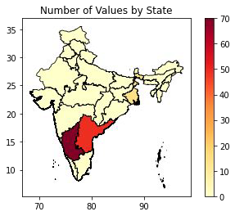
Location
State | Workers in state
Karnataka | 70
Andhra Pradesh | 50
Maharashtra | 49
Delhi | 14
West Bengal | 14
Chandigarh | 6
Tamil Nadu | 1
This slide shows the number of workers located in each state and a corresponding visualization on the Indian map.

Slide 6

Word cloud
A word cloud | of the most
common words | appearing in | the
resumes.
Our observations emphasized that
'application', 'team', 'management',
'year', 'project', 'client', 'service'
are
most common words used in the resumes.

Slide 7
N-GRAM ANALYSIS
N-gram analysis is a technique used in natural language processing to extract contiguous sequences of n items (typically words) from a text. It helps identify patterns, relationships, and frequencies of word sequences, enabling insights into language usage and context.
We computed unigrams, bigrams and trigrams to successfully detect most commonly used word groups.

Slide 8
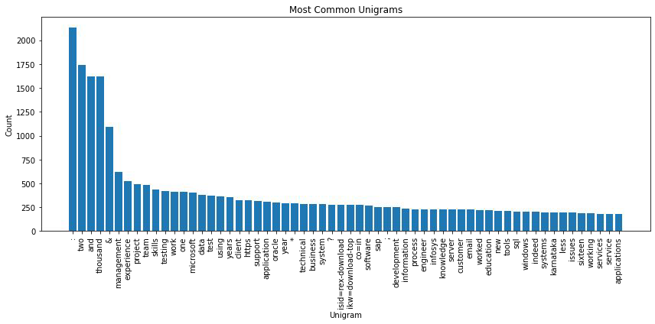
Unigrams
Bar plot illustrates that monst commonly used unigrams
are
‘:’, ‘two’, ‘and’,
‘thousand’

Slide 9
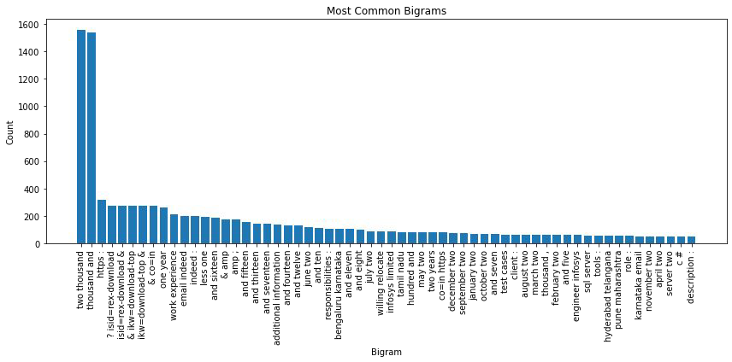
bigrams
Bar plot illustrates that monst commonly used
bigrams are,
‘two
thousand’, ‘thousand and’

Slide 10
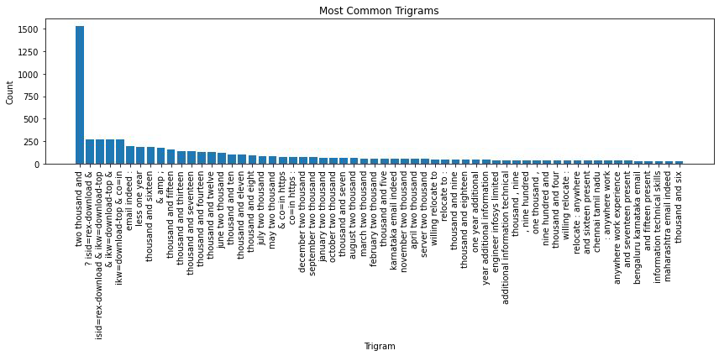
trigrams
Bar plot illustrates that monst commonly used
trigram is
‘two thousand
and’

Slide 11
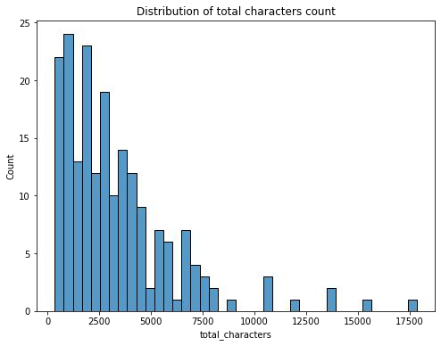
Character count
The average number of characters in the resumes is 3337 ± 2850 words.
The resume with the fewest words is
337 while the highest is 17866 words.

Slide 12
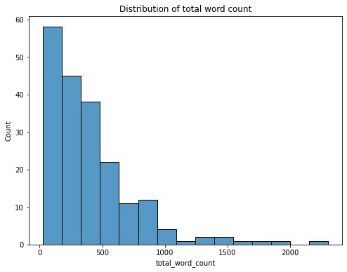
Word count
The average number of words in the resumes is 406 ± 362 words. The resume with the fewest words is 28 while the highest is 2801 words.

Slide 13
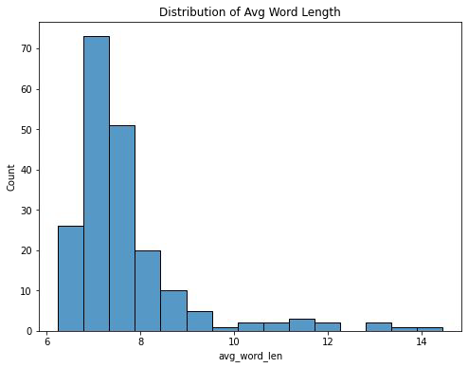
Average word length in resumes
The average length of the words in the resumes is 7.70 ± 1.32 characters. The shortest average word length is 6.24 while the highest is 14.4 words.

Slide 14
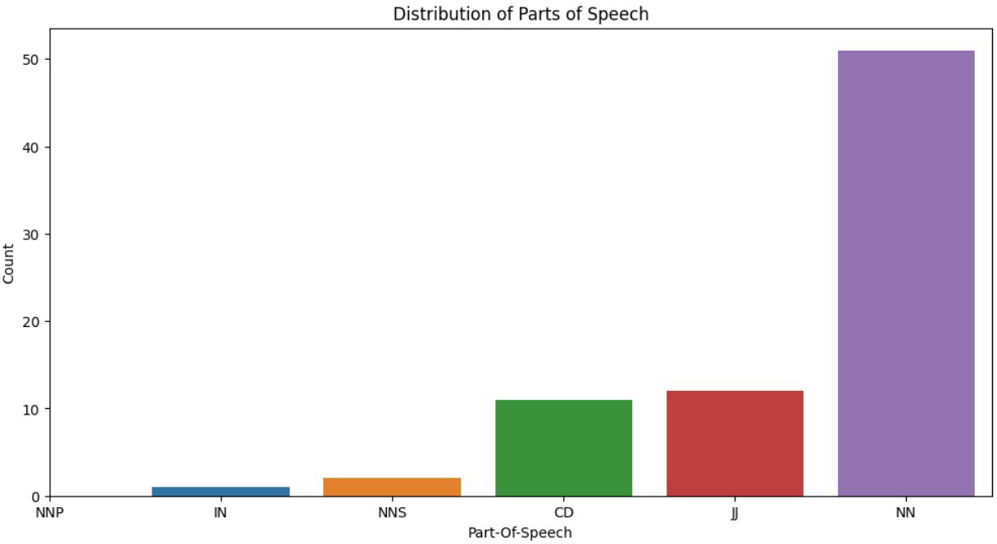
Parts of speech analysis
When specifying the resume details, singular nouns dominate the description of each candidate. This showcases. This in turn can highlight the use of concrete details in most resumes to satisfy ATS format.

Slide 15
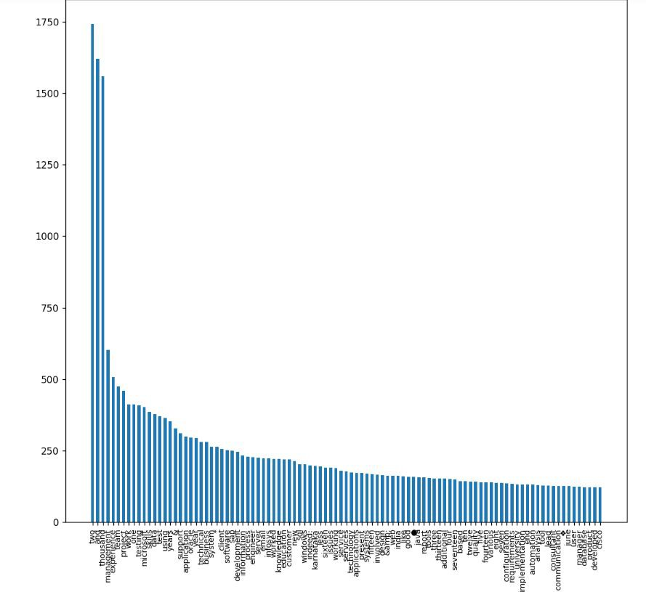
Frequency Distribution of 100 Most common words
"Experience" ranked as the fifth most commonly used word, emphasizing its importance in the job market over education.
Management experience is listed as the fourth most sought-after skill by employers.
Microsoft and Oracle are the most frequently mentioned companies on applicants' resumes.

Slide 16
Proposed model
We are proposing a Named Entity Recognition model for further use
Reasons:-
It allows us to classify data according to field(Location, Name, Companies Worked At, College etc.)
It is an NLP technique.
NER can deal with unstructured text.
It is the most appropriate model for parsing resumes.
It can extract and identify important information from the text while discarding superfluous information.

Slide 17
Final model
The NER model we used was from python’s SpaCy package to fetch resume details.
SpaCy's models are statistical and rely on patterns in training data to make predictions. These predictions are probabilistic and not absolute. The accuracy depends on the quality of training data.
After we created our model, we saved our training data to disk and choose a specific resume for testing.
Once a resume was selected, we named the entities as before.

Slide 18
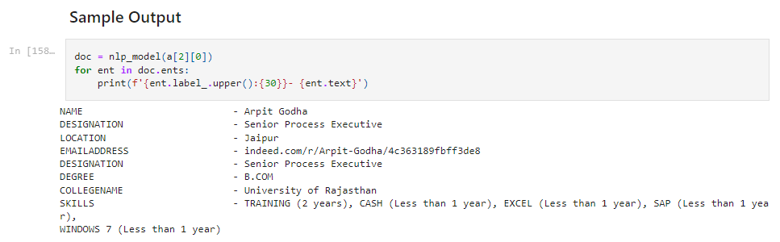
Sample model output

Slide 19
THANK YOU!

